Slide 1


Slide 2
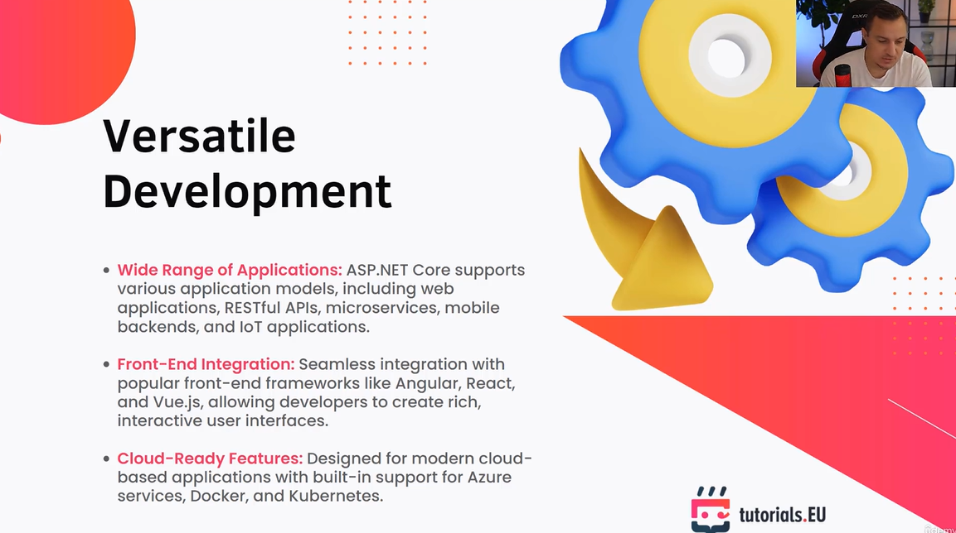

Slide 3
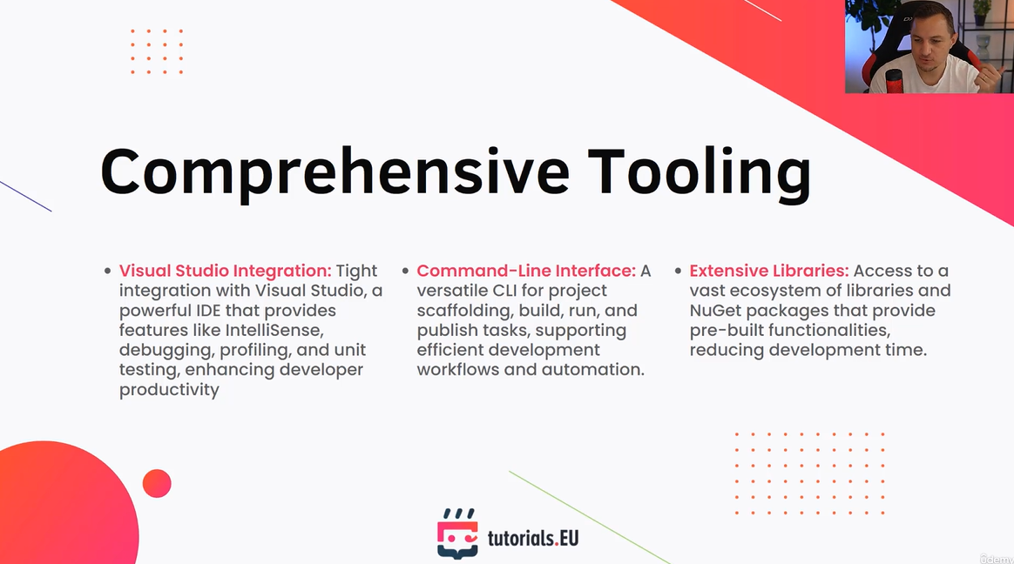

Slide 4


Slide 5
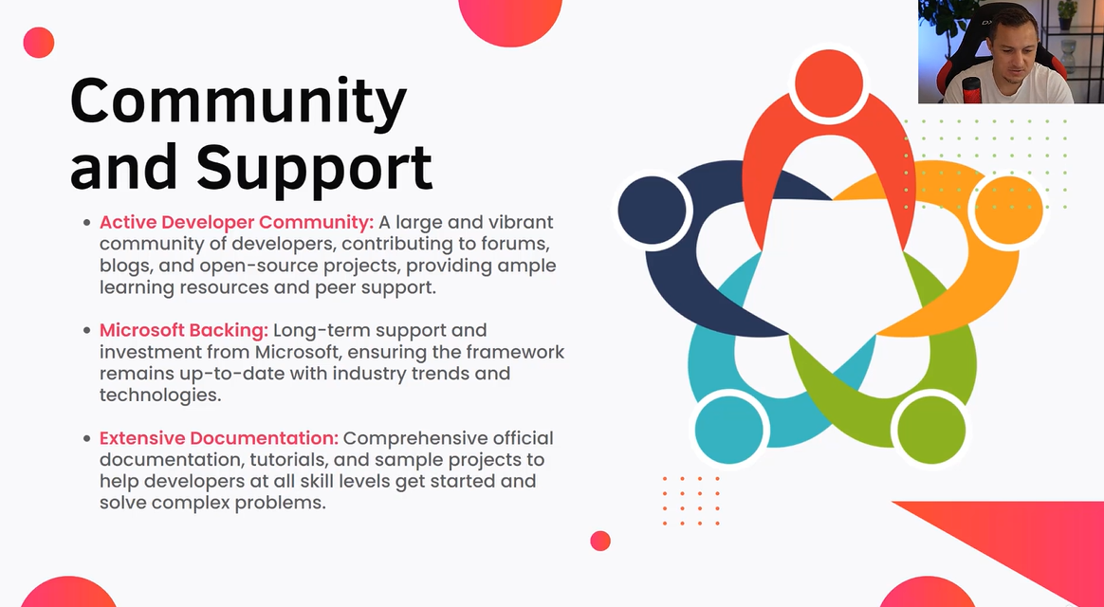

Slide 6


Slide 7


Slide 8
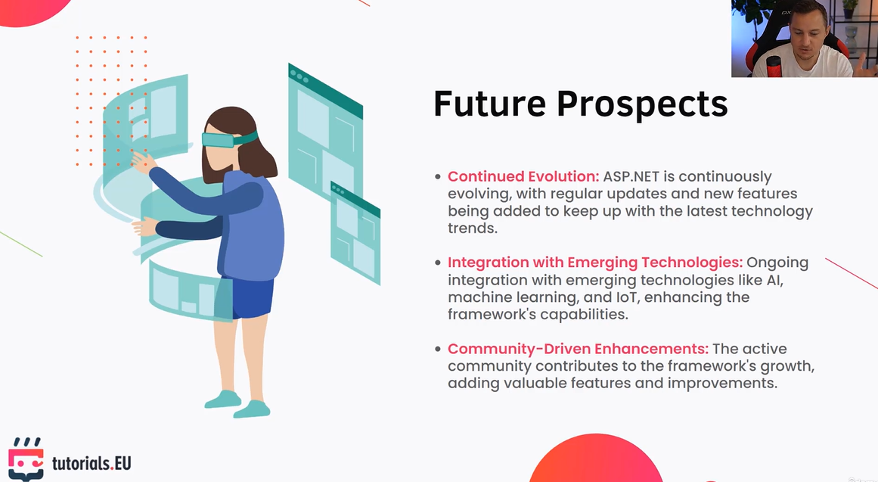

Slide 9


Slide 10
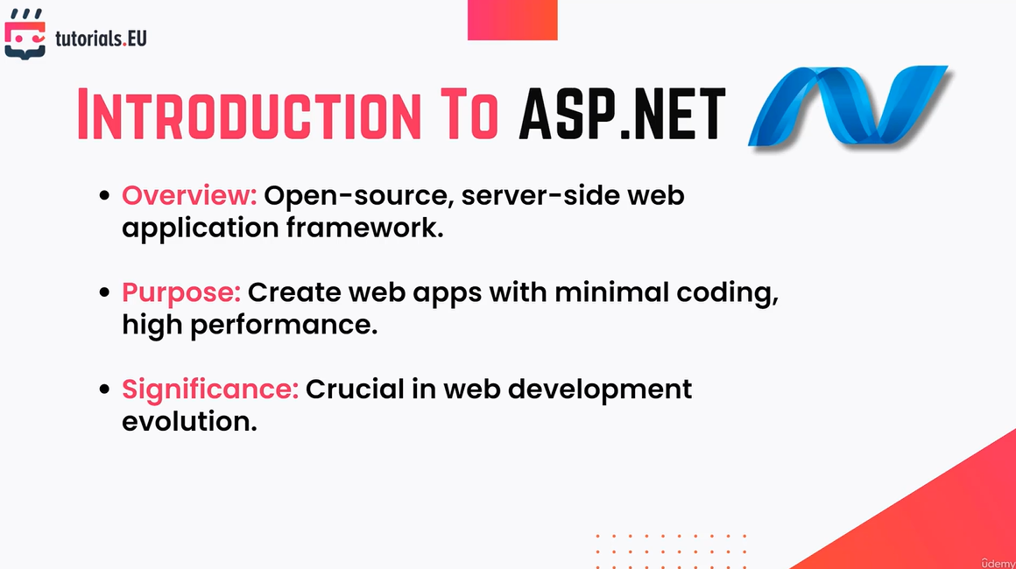

Slide 11
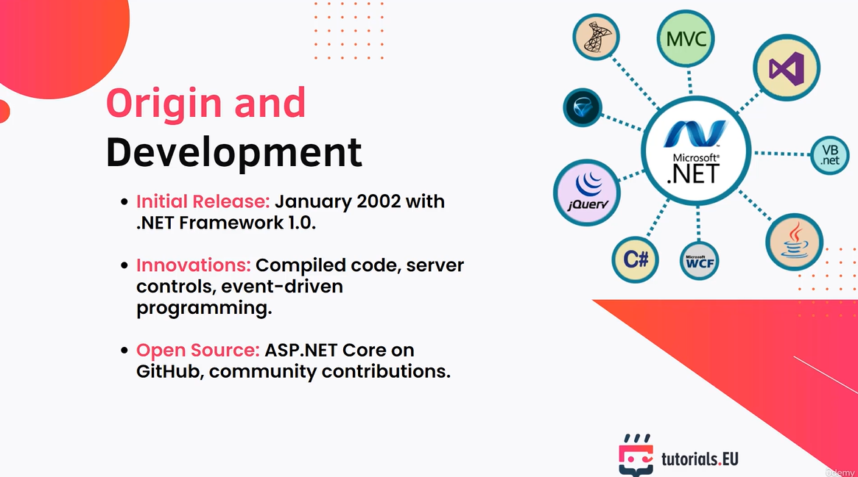

Slide 12
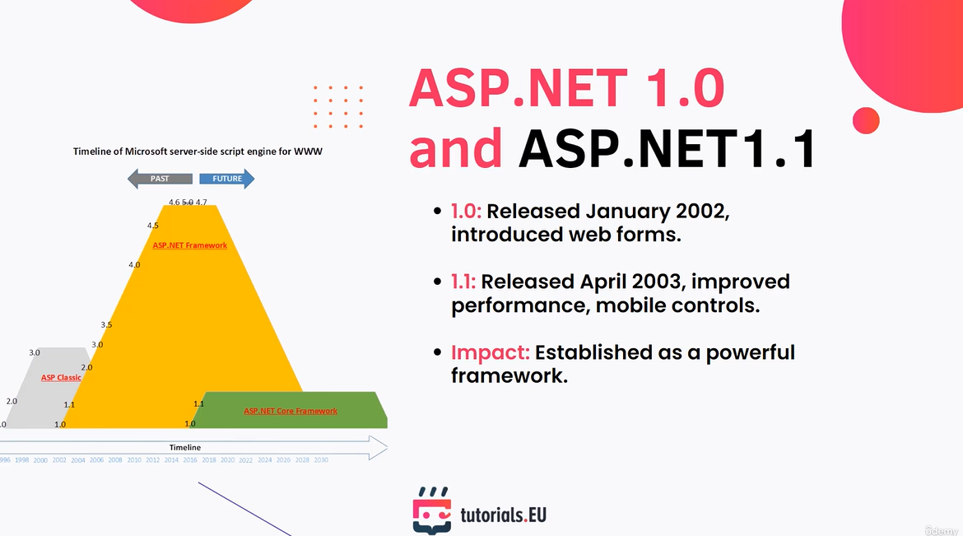

Slide 13
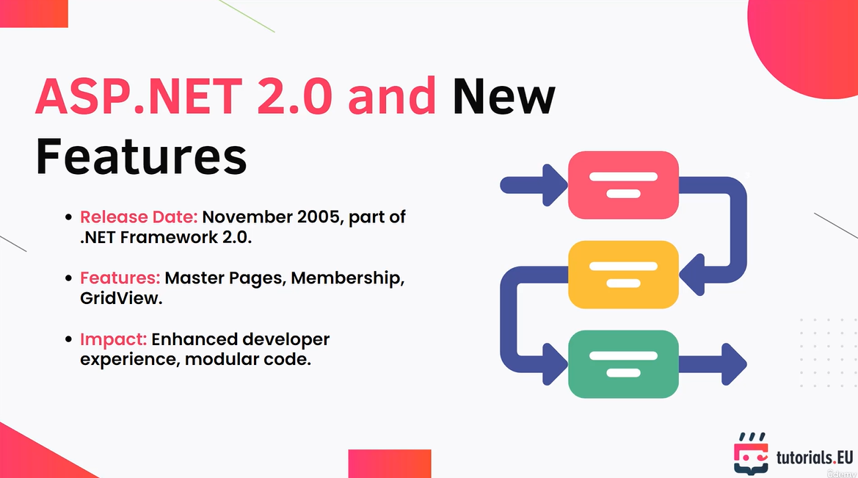

Slide 14
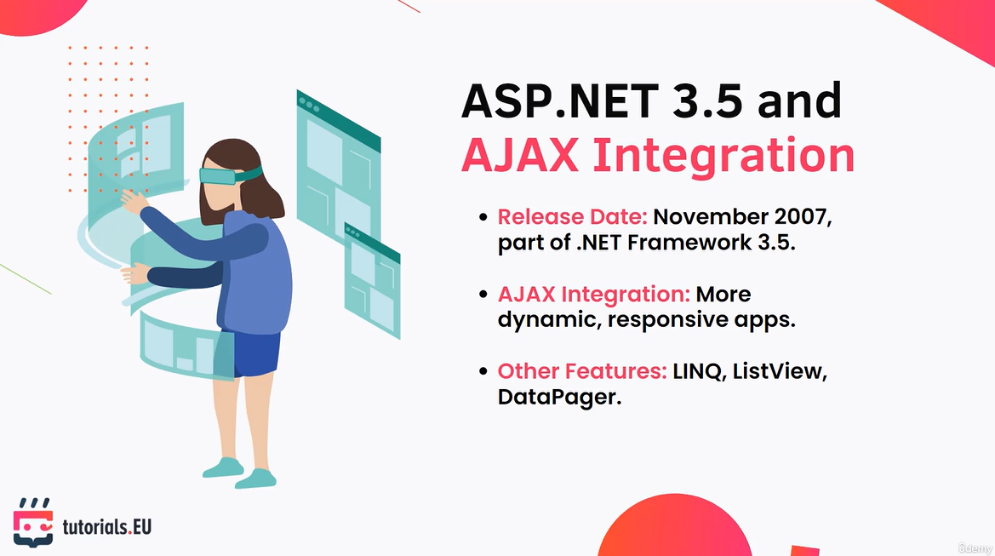

Slide 15
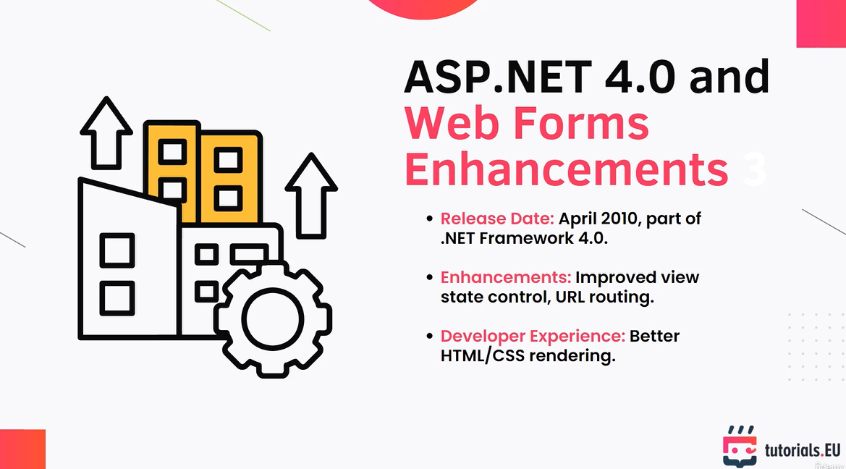

Slide 16
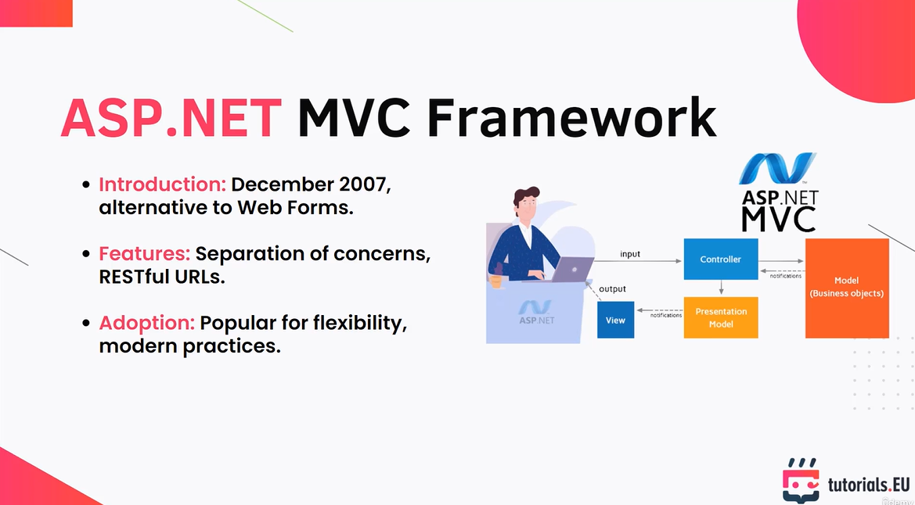

Slide 17
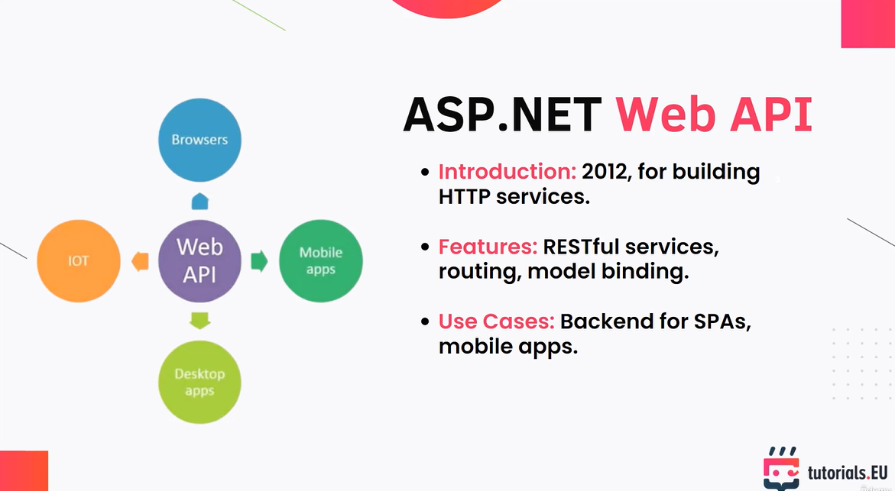

Slide 18
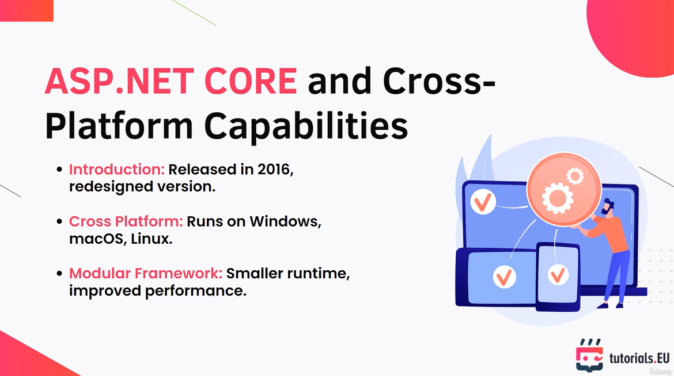

Slide 20
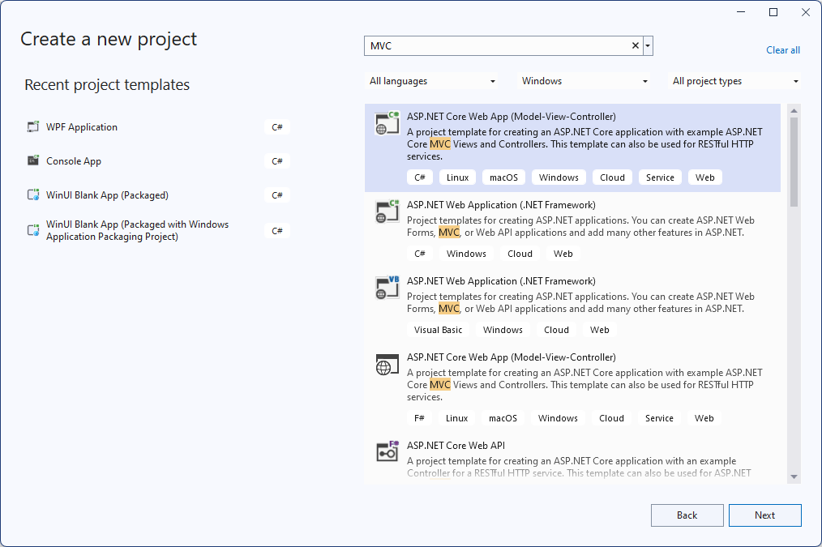

Slide 21
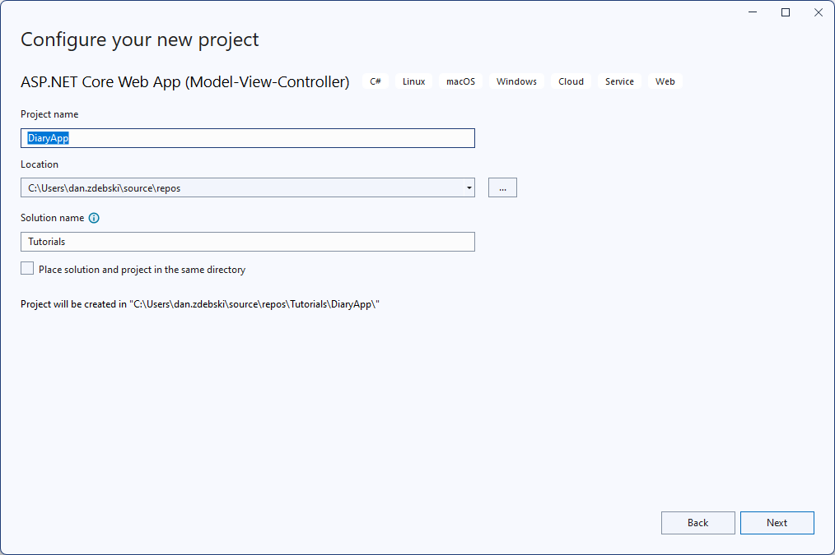

Slide 22
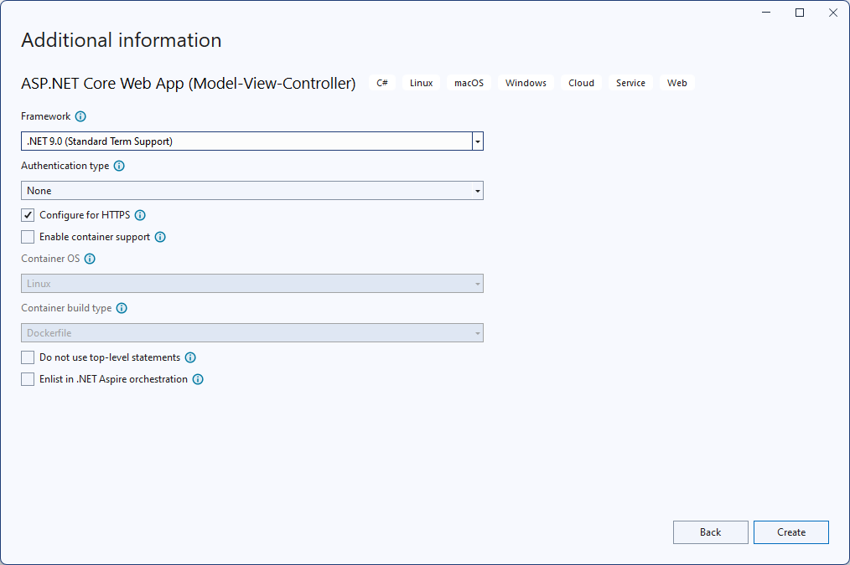

Slide 23
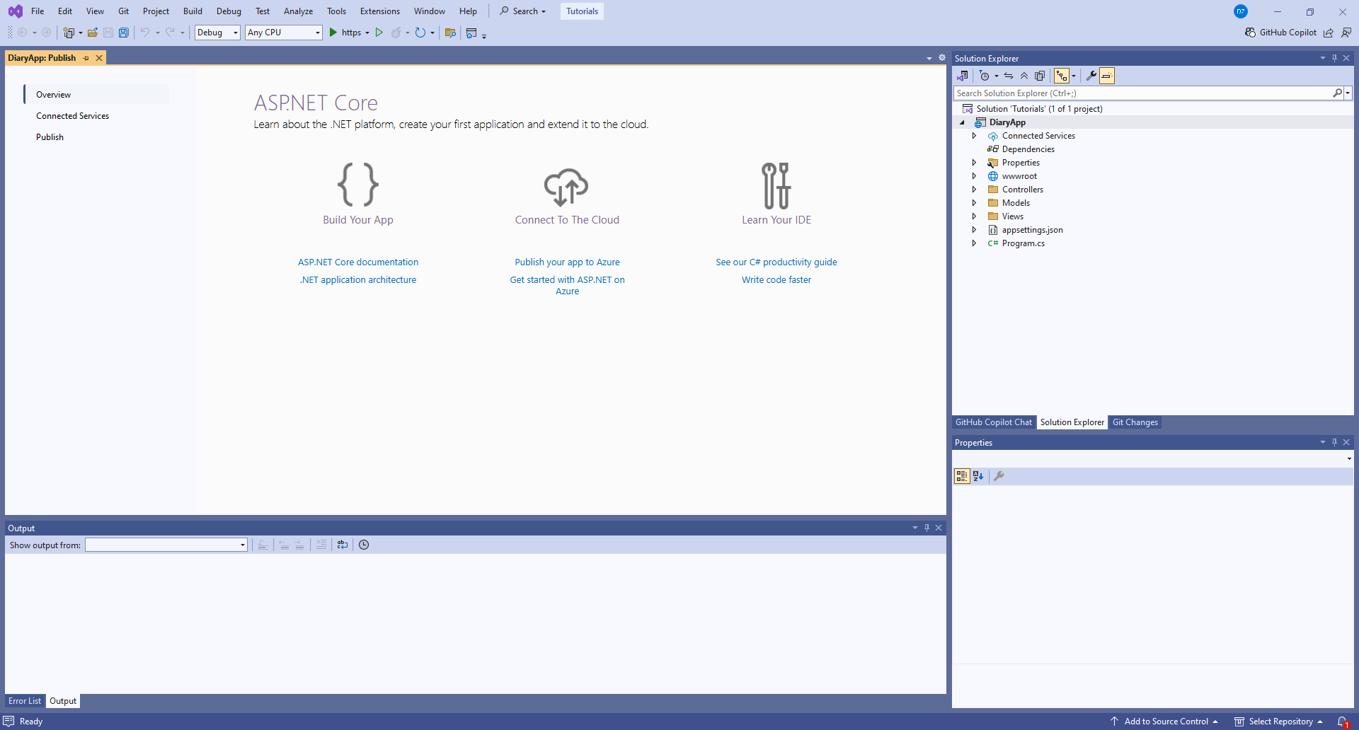

Slide 24
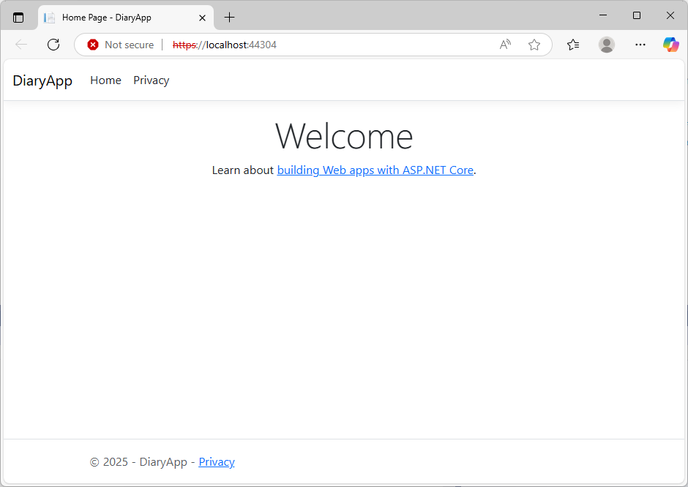
Run the project. Default webapp is shown:

Slide 25
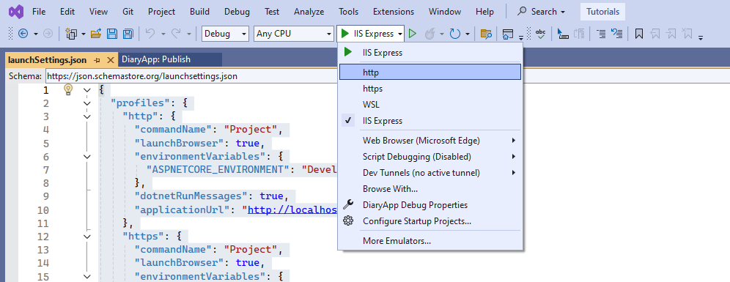
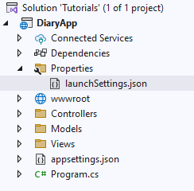
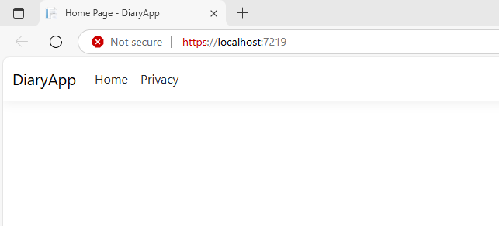
{
"profiles": {
"http": {
"commandName": "Project",
"launchBrowser": true,
"environmentVariables": {
"ASPNETCORE_ENVIRONMENT": "Development"
},
"dotnetRunMessages": true,
"applicationUrl": "http://localhost:5119"
},
"https": {
"commandName": "Project",
"launchBrowser": true,
"environmentVariables": {
"ASPNETCORE_ENVIRONMENT": "Development"
},
"dotnetRunMessages": true,
"applicationUrl": "https://localhost:7219;http://localhost:5119"
},
"IIS Express": {
"commandName": "IISExpress",
"launchBrowser": true,
"environmentVariables": {
"ASPNETCORE_ENVIRONMENT": "Development"
}
}
},
"$schema": "https://json.schemastore.org/launchsettings.json",
"iisSettings": {
"windowsAuthentication": false,
"anonymousAuthentication": true,
"iisExpress": {
"applicationUrl": "http://localhost:61082/",
"sslPort": 44304
}
}
}
Profiles
HTTPS may need some certificates to be installed.
Development
Staging
Production
Schema defines the project type. It is an important part of the launch setting.
IIS – Internet Information Services – is used to run the project locally.

Slide 26
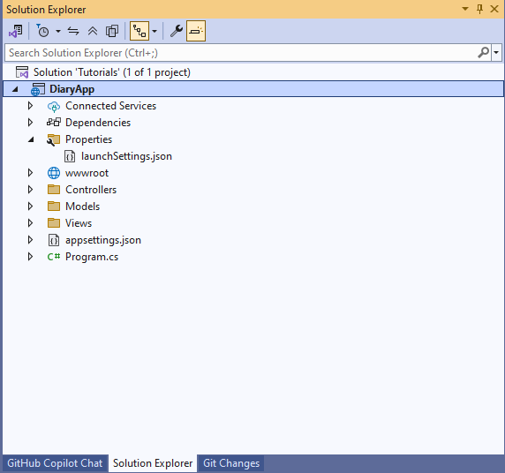
Project file
<Project Sdk="Microsoft.NET.Sdk.Web">
<PropertyGroup>
<TargetFramework>net9.0</TargetFramework>
<Nullable>enable</Nullable>
<ImplicitUsings>enable</ImplicitUsings>
</PropertyGroup>
</Project>
Enabling nullable reference properties. This was introduced in NET 8.0
This enables global usings which do not need to be explicitly included in the file.

Slide 27
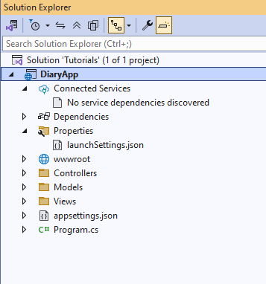
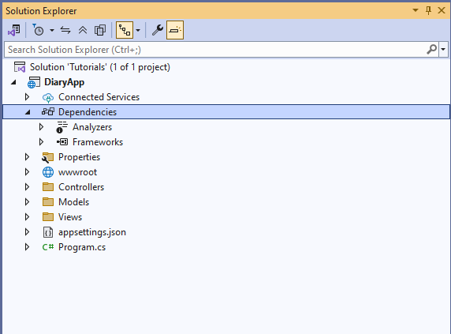
Connected services:
Currently no services are included.
This is where services such as AZURE services will be included.
Dependecies:
Includes external libraries such as Nugets.

Slide 28
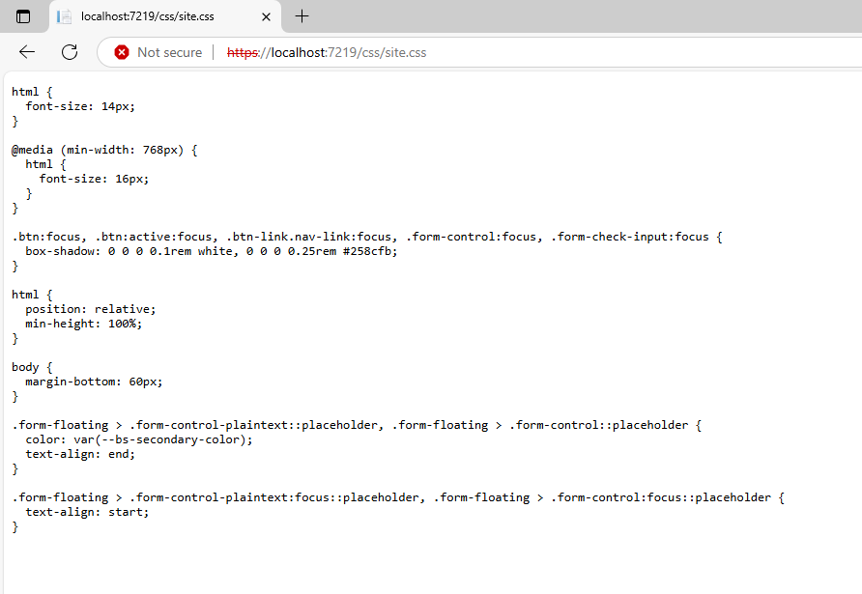
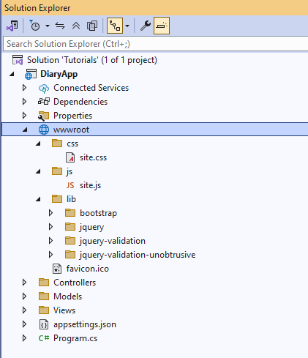
Wwwroot
Includes only static files, front-end only.
These are directly accessible via url.

Slide 29
MVC
Database
View
Handles data presentation
Dynamically rendered
Model
Handles data logic
Interacts with database
Fetch data
Controller
Handles request flow
- never handles data logic
End User
Request
Fetch presentation
Response

Slide 30
MVC
Database
View
Represents the user interface
Model
Represents the shape of the data
2 Get data
Controller
Handles the user request and act as an interface between model and view
End User
1 Request
3 Get presentation
4 Response

Slide 31
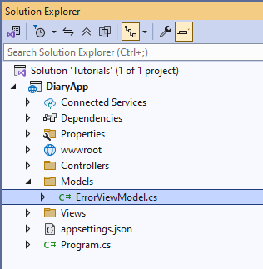
Model
- Currently has only one class (ErrorViewModel.cs)
namespace DiaryApp.Models
{
public class ErrorViewModel
{
public string? RequestId { get; set; }
public bool ShowRequestId => !string.IsNullOrEmpty(RequestId);
}
}

Slide 32
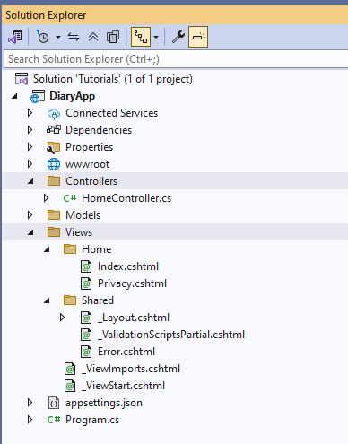
Views and Controllers

Slide 33
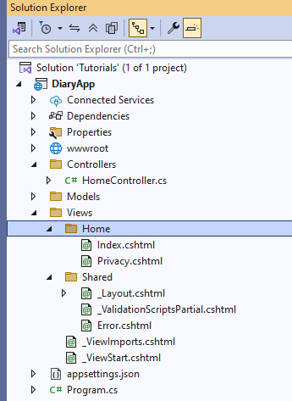
using System.Diagnostics;
using DiaryApp.Models;
using Microsoft.AspNetCore.Mvc;
namespace DiaryApp.Controllers
{
public class HomeController : Controller
{
private readonly ILogger<HomeController> _logger;
public HomeController(ILogger<HomeController> logger)
{
_logger = logger;
}
public IActionResult Index()
{
return View();
}
public IActionResult Privacy()
{
return View();
}
[ResponseCache(Duration = 0, Location = ResponseCacheLocation.None, NoStore = true)]
public IActionResult Error()
{
return View(new ErrorViewModel { RequestId = Activity.Current?.Id ?? HttpContext.TraceIdentifier });
}
}
}
Must have same name

Slide 34
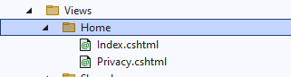
using System.Diagnostics;
using DiaryApp.Models;
using Microsoft.AspNetCore.Mvc;
namespace DiaryApp.Controllers
{
public class HomeController : Controller
{
private readonly ILogger<HomeController> _logger;
public HomeController(ILogger<HomeController> logger)
{
_logger = logger;
}
public IActionResult Index()
{
return View();
}
public IActionResult Privacy()
{
return View();
}
[ResponseCache(Duration = 0, Location = ResponseCacheLocation.None, NoStore = true)]
public IActionResult Error()
{
return View(new ErrorViewModel { RequestId = Activity.Current?.Id ?? HttpContext.TraceIdentifier });
}
}
}
Returns the view.

Slide 35
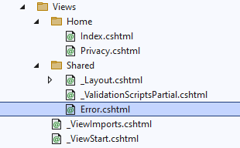
using System.Diagnostics;
using DiaryApp.Models;
using Microsoft.AspNetCore.Mvc;
namespace DiaryApp.Controllers
{
public class HomeController : Controller
{
private readonly ILogger<HomeController> _logger;
public HomeController(ILogger<HomeController> logger)
{
_logger = logger;
}
public IActionResult Index()
{
return View();
}
public IActionResult Privacy()
{
return View();
}
[ResponseCache(Duration = 0, Location = ResponseCacheLocation.None, NoStore = true)]
public IActionResult Error()
{
return View(new ErrorViewModel { RequestId = Activity.Current?.Id ?? HttpContext.TraceIdentifier });
}
}
}

Slide 36

@{
ViewData["Title"] = "Home Page";
}
<div class="text-center">
<h1 class="display-4">Welcome</h1>
<p>Learn about <a href="https://learn.microsoft.com/aspnet/core">building Web apps with ASP.NET Core</a>.</p>
</div>
<h1 class="display-4">Hello World</h1>

Slide 37
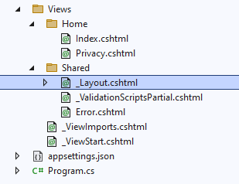
<!DOCTYPE html>
<html lang="en">
<head>
<meta charset="utf-8" />
<meta name="viewport" content="width=device-width, initial-scale=1.0" />
<title>@ViewData["Title"] - DiaryApp</title>
<script type="importmap"></script>
<link rel="stylesheet" href="~/lib/bootstrap/dist/css/bootstrap.min.css" />
<link rel="stylesheet" href="~/css/site.css" asp-append-version="true" />
<link rel="stylesheet" href="~/DiaryApp.styles.css" asp-append-version="true" />
</head>
<body>
<header>
<nav class="navbar navbar-expand-sm navbar-toggleable-sm navbar-light bg-white border-bottom box-shadow mb-3">
<div class="container-fluid">
<a class="navbar-brand" asp-area="" asp-controller="Home" asp-action="Index">DiaryApp</a>
<button class="navbar-toggler" type="button" data-bs-toggle="collapse" data-bs-target=".navbar-collapse" aria-controls="navbarSupportedContent"
aria-expanded="false" aria-label="Toggle navigation">
<span class="navbar-toggler-icon"></span>
</button>
<div class="navbar-collapse collapse d-sm-inline-flex justify-content-between">
<ul class="navbar-nav flex-grow-1">
<li class="nav-item">
<a class="nav-link text-dark" asp-area="" asp-controller="Home" asp-action="Index">Home</a>
</li>
<li class="nav-item">
<a class="nav-link text-dark" asp-area="" asp-controller="Home" asp-action="Privacy">Privacy</a>
</li>
</ul>
</div>
</div>
</nav>
</header>
<div class="container">
<main role="main" class="pb-3">
@RenderBody()
</main>
</div>
<footer class="border-top footer text-muted">
<div class="container">
&copy; 2025 - DiaryApp - <a asp-area="" asp-controller="Home" asp-action="Privacy">Privacy</a>
</div>
</footer>
<script src="~/lib/jquery/dist/jquery.min.js"></script>
<script src="~/lib/bootstrap/dist/js/bootstrap.bundle.min.js"></script>
<script src="~/js/site.js" asp-append-version="true"></script>
@await RenderSectionAsync("Scripts", required: false)
</body>
</html>
This is where the footer and header comes from

Slide 38
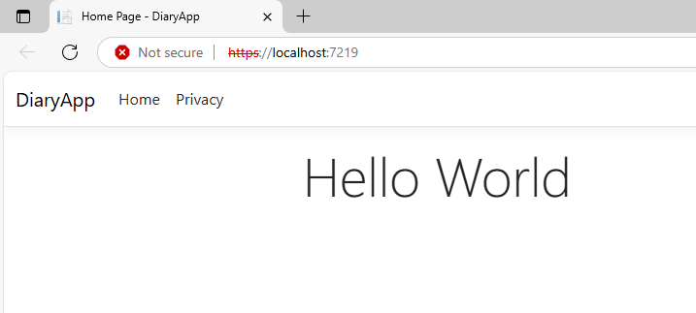
In _Layout.cshtml
<!DOCTYPE html>
<html lang="en">
<head>
<meta charset="utf-8" />
<meta name="viewport" content="width=device-width, initial-scale=1.0" />
<title>@ViewData["Title"] - DiaryApp</title>
<script type="importmap"></script>
<link rel="stylesheet" href="~/lib/bootstrap/dist/css/bootstrap.min.css" />
<link rel="stylesheet" href="~/css/site.css" asp-append-version="true" />
<link rel="stylesheet" href="~/DiaryApp.styles.css" asp-append-version="true" />
</head>
<body>
…
</body>
</html>
In Home.cshtml
@{
ViewData["Title"] = "Home Page";
}
<h1 class="display-4">Hello World</h1>
C# code

Slide 39
<!DOCTYPE html>
<html lang="en">
<head>
<meta charset="utf-8" />
<meta name="viewport" content="width=device-width, initial-scale=1.0" />
<title>@ViewData["Title"] - DiaryApp</title>
<script type="importmap"></script>
<link rel="stylesheet" href="~/lib/bootstrap/dist/css/bootstrap.min.css" />
<link rel="stylesheet" href="~/css/site.css" asp-append-version="true" />
<link rel="stylesheet" href="~/DiaryApp.styles.css" asp-append-version="true" />
</head>
<body>
…
<div class="container">
<main role="main" class="pb-3">
@RenderBody()
</main>
</div>
<footer class="border-top footer text-muted">
<div class="container">
&copy; 2025 - DiaryApp - <a asp-area="" asp-controller="Home" asp-action="Privacy">Privacy</a>
</div>
</footer>
<script src="~/lib/jquery/dist/jquery.min.js"></script>
<script src="~/lib/bootstrap/dist/js/bootstrap.bundle.min.js"></script>
<script src="~/js/site.js" asp-append-version="true"></script>
@await RenderSectionAsync("Scripts", required: false)
</body>
</html>
This is where the body (e.g. index, privacy.cshtml) is rendered.

Slide 40
<!DOCTYPE html>
<html lang="en">
<head>
<meta charset="utf-8" />
<meta name="viewport" content="width=device-width, initial-scale=1.0" />
<title>@ViewData["Title"] - DiaryApp</title>
<script type="importmap"></script>
<link rel="stylesheet" href="~/lib/bootstrap/dist/css/bootstrap.min.css" />
<link rel="stylesheet" href="~/css/site.css" asp-append-version="true" />
<link rel="stylesheet" href="~/DiaryApp.styles.css" asp-append-version="true" />
</head>
<body>
…
<div class="container">
<main role="main" class="pb-3">
@RenderBody()
</main>
</div>
<footer class="border-top footer text-muted">
<div class="container">
&copy; 2025 - DiaryApp - <a asp-area="" asp-controller="Home" asp-action="Privacy">Privacy</a>
</div>
</footer>
<script src="~/lib/jquery/dist/jquery.min.js"></script>
<script src="~/lib/bootstrap/dist/js/bootstrap.bundle.min.js"></script>
<script src="~/js/site.js" asp-append-version="true"></script>
@await RenderSectionAsync("Scripts", required: false)
</body>
</html>
@{
ViewData["Title"] = "Home Page";
}
<h1 class="display-4">Hello World</h1>
@section Scripts{
}

Slide 41
Inside of _ViewStart.cshtml
Is defined the startup view.
@{
Layout = "_Layout";
}

Slide 42
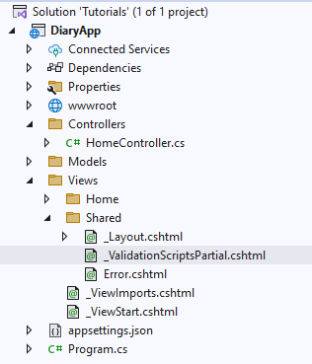
<script src="~/lib/jquery-validation/dist/jquery.validate.min.js"></script>
<script src="~/lib/jquery-validation-unobtrusive/dist/jquery.validate.unobtrusive.min.js"></script>
This file is partial, meaning it can only be run as part of other file.
Currently it has some validation scripts inside.

Slide 43
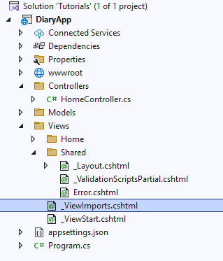
@using DiaryApp
@using DiaryApp.Models
@addTagHelper *, Microsoft.AspNetCore.Mvc.TagHelpers
This file defines the using; what libraries shall be given access to in all cshtml (global using).
addTagHelper -
This is the tagHelper
<!DOCTYPE html>
<html lang="en">
<head>
<meta charset="utf-8" />
<meta name="viewport" content="width=device-width, initial-scale=1.0" />
<title>@ViewData["Title"] - DiaryApp</title>
<script type="importmap"></script>
<link rel="stylesheet" href="~/lib/bootstrap/dist/css/bootstrap.min.css" />
<link rel="stylesheet" href="~/css/site.css" asp-append-version="true" />
<link rel="stylesheet" href="~/DiaryApp.styles.css" asp-append-version="true" />
</head>
<body>
…
<div class="container">
<main role="main" class="pb-3">
@RenderBody()
</main>
</div>
<footer class="border-top footer text-muted">
<div class="container">
&copy; 2025 - DiaryApp - <a asp-area="" asp-controller="Home" asp-action="Privacy">Privacy</a>
</div>
</footer>
<script src="~/lib/jquery/dist/jquery.min.js"></script>
<script src="~/lib/bootstrap/dist/js/bootstrap.bundle.min.js"></script>
<script src="~/js/site.js" asp-append-version="true"></script>
@await RenderSectionAsync("Scripts", required: false)
</body>
</html>

Slide 44
ErrorViewModel
namespace DiaryApp.Models
{
public class ErrorViewModel
{
public string? RequestId { get; set; }
public bool ShowRequestId => !string.IsNullOrEmpty(RequestId);
}
}
@model ErrorViewModel
@{
ViewData["Title"] = "Error";
}
<h1 class="text-danger">Error.</h1>
<h2 class="text-danger">An error occurred while processing your request.</h2>
@if (Model.ShowRequestId)
{
<p>
<strong>Request ID:</strong> <code>@Model.RequestId</code>
</p>
}
<h3>Development Mode</h3>
<p>
Swapping to <strong>Development</strong> environment will display more detailed information about the error that occurred.
</p>
<p>
<strong>The Development environment shouldn't be enabled for deployed applications.</strong>
It can result in displaying sensitive information from exceptions to end users.
For local debugging, enable the <strong>Development</strong> environment by setting the <strong>ASPNETCORE_ENVIRONMENT</strong> environment variable to <strong>Development</strong>
and restarting the app.
</p>

Slide 45
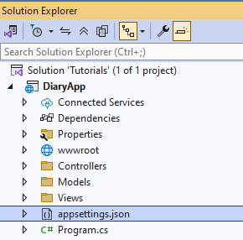
Appsettings.json
{
"Logging": {
"LogLevel": {
"Default": "Information",
"Microsoft.AspNetCore": "Warning"
}
},
"AllowedHosts": "*"
}

Slide 46
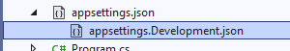
It has some subsettings too. Currently we only have development one

Slide 47
Understanding Program.cs in ASP.NET
Title: Understanding Program.cs in ASP.NET Core
Subtitle: A Deep Dive into Dependency Injection, Services, and Meddleware

Slide 48
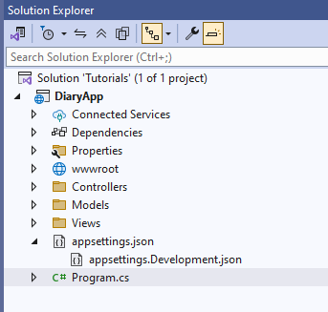
Purpose: entry point of the ASP.NET Core application.
WebApplication Builder: Configures the application’s services and middleware.
Services Configuration: Registers and configures services required by the application.
Middleware Configuration: Sets up the request processing pipeline, defining how requests are handled.

Slide 49
var builder = WebApplication.CreateBuilder(args);
// Add services to the container.
builder.Services.AddControllersWithViews();
var app = builder.Build();
// Configure the HTTP request pipeline.
if (!app.Environment.IsDevelopment())
{
app.UseExceptionHandler("/Home/Error");
// The default HSTS value is 30 days. You may want to change this for production scenarios, see https://aka.ms/aspnetcore-hsts.
app.UseHsts();
}
app.UseHttpsRedirection();
app.UseRouting();
app.UseAuthorization();
app.MapStaticAssets();
app.MapControllerRoute(
name: "default",
pattern: "{controller=Home}/{action=Index}/{id?}")
.WithStaticAssets();
app.Run();
Service Configuration
var builder = WebApplication.CreateBuilder(args);
builder.Services.AddControllersWithViews();
Creates a new instance of WebApplicationBuilder with the command-line arguments.
Adds the MVC controllers with views to the service container.
Application Build
var app = builder.Build();
Builds the web application.
Environment-Specific Configuration
if (!app.Environment.IsDevelopment())
{
app.UseExceptionHandler("/Home/Error");
app.UseHsts();
}
Configures error handling and HSTS (HTTP Script Transport Security) for non-development environments.
Middleware Configuration
app.UseHttpsRedirection();
app.UseRouting();
app.UseAuthorization();
app.MapStaticAssets();
app.UseHttpsRedirection(): Redirects HTTP requests to HTTPS.
app.UseRouting(): Adds routing capabilities.
app.UseAuthorization(): Adds authorization capabilities.
App.MapStaticAsses(): Serves static files.
Routing Configuration
app.MapControllerRoute(
name: "default",
pattern: "{controller=Home}/{action=Index}/{id?}")
.WithStaticAssets();
Defines the default route for the application.
Run the Application
app.Run();
Runs the web application.

Slide 50
WebApplication Builder
Purpose: Configures the application and services.
Sets up configuration and logging: Initializes configuration sources and logging providers.
Initializes the Dependency Injection (DI) container: Sets up the container that manages service dependencies.
Code: var builder = WebApplication.CreateBuilder(args);
Dependency Injection
(DI) Container
Definition: A design pattern that allows a class to receive its dependencies from an external source.
Promotes loose coupling: Reduces the dependencies between components, making the system more modular.
Code: var builder = WebApplication.Services.AddControllersWithView();
Adding Services
Purpose: Registers services required by the application.
Common Services:
Controllers: Handle HTTP requests and generate responses.
Views: Render HTML pages
Razor Pages: Simplified model for creating web pages.
Code: builder.Services.AddControllersWithViews();

Slide 51
Building the Application
Purpose: Compiles the configuration and services into a web application instance.
Responsibilities: Prepares the app for request handling by combining all configurations and registered services.
Code: var app = builder.Build();

Slide 52
Middleware Configuration
Purpose: Defines the request processing pipeline.
Code:
if (!app.Environment.IsDevelopment())
{
app.UseExceptionHandler("/Home/Error");
app.UseHsts();
}
app.UseHttpsRedirection();
app.UseRouting();
app.UseAuthorization();
app.MapStaticAssets();
Components:
Exception Handling: Adds error handling middleware to catch and handle exceptions, redirecting to a specified error pages.
HSTS (HTTP Strict Transport Security): Adds HSTS middleware to enforce HTTPS by adding the Strict-Transport-Security header.
HTTPS Redirection: Redirects HTTP requests to HTTPS to ensure secure communication.
Static Files: Serves static files such as HTML, CSS, Images, and JasvaScript from wwwroot folder.
Routing: Matches request URLs to the corresponding route handlers.
Authorization: Enforces authorization policies within the application.

Slide 53
Exception Handling and HSTS
Exception Handling: Manages errors and exceptions in a controlled manner.
Code: app.UserExceptionHandler(“/Home/Error”);
HSTS (HTTP Strict Transport Security): Enforces the use of HTTPS.
Code: app.userHsts();
Purpose: Enhances security and error management.
Routing and Authorization
Routing: Directs requests to the appropriate controllers and actions.
Code: app.UseRouting(0);
Authorization: Verifies that users have permission to access requested resources.
Code: app.UseAuthorization();
Purpose: Manages how requests are routed and ensures security.
HTTPS Redirection and static files
HTTPS Redirection: Redirects all HTTP requests to HTTPS.
Code: app.UseHttpsRedicrection();
Static Files: Serves static files from the wwroot directory.
Code: app.MapStaticAsses();
Purpose: Improves security and serves essential static content.

Slide 54
Configuring Routes
Default Route Configuration: Defines URL patterns and maps them to controllers and actions.
Code:
app.MapControllerRoute(
name: "default",
pattern: "{controller=Home}/{action=Index}/{id?}")
.WithStaticAssets();
Purpose: Ensures requests are directed to the correct handlers based on URL patterns.
Running the Application
Code: app.Run();
Purpose: Starts the web server and begins listening for HTTP requests.

Slide 55
Summary
Key Takeaways:
Program.cs initializes the application.
DI container manages service dependencies.
Middleware defines the request processing pipeline.
Services and routing are configured to handle requests.

Slide 56
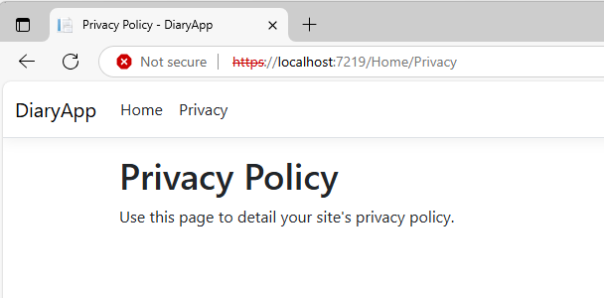
Routing
var builder = WebApplication.CreateBuilder(args);
builder.Services.AddControllersWithViews();
var app = builder.Build();
if (!app.Environment.IsDevelopment())
{
app.UseExceptionHandler("/Home/Error");
app.UseHsts();
}
app.UseHttpsRedirection();
app.UseRouting();
app.UseAuthorization();
app.MapStaticAssets();
app.MapControllerRoute(
name: "default",
pattern: "{controller=Home}/{action=Index}/{id?}")
.WithStaticAssets();
app.Run();
Pattern to be used.

Slide 57
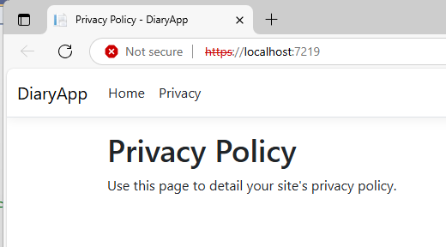
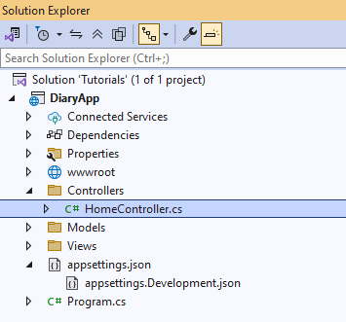
app.MapControllerRoute(
name: "default",
pattern: "{controller=Home}/{action=Privacy}/{id?}")
.WithStaticAssets();
public IActionResult Privacy()
{
return View();
}

Slide 58
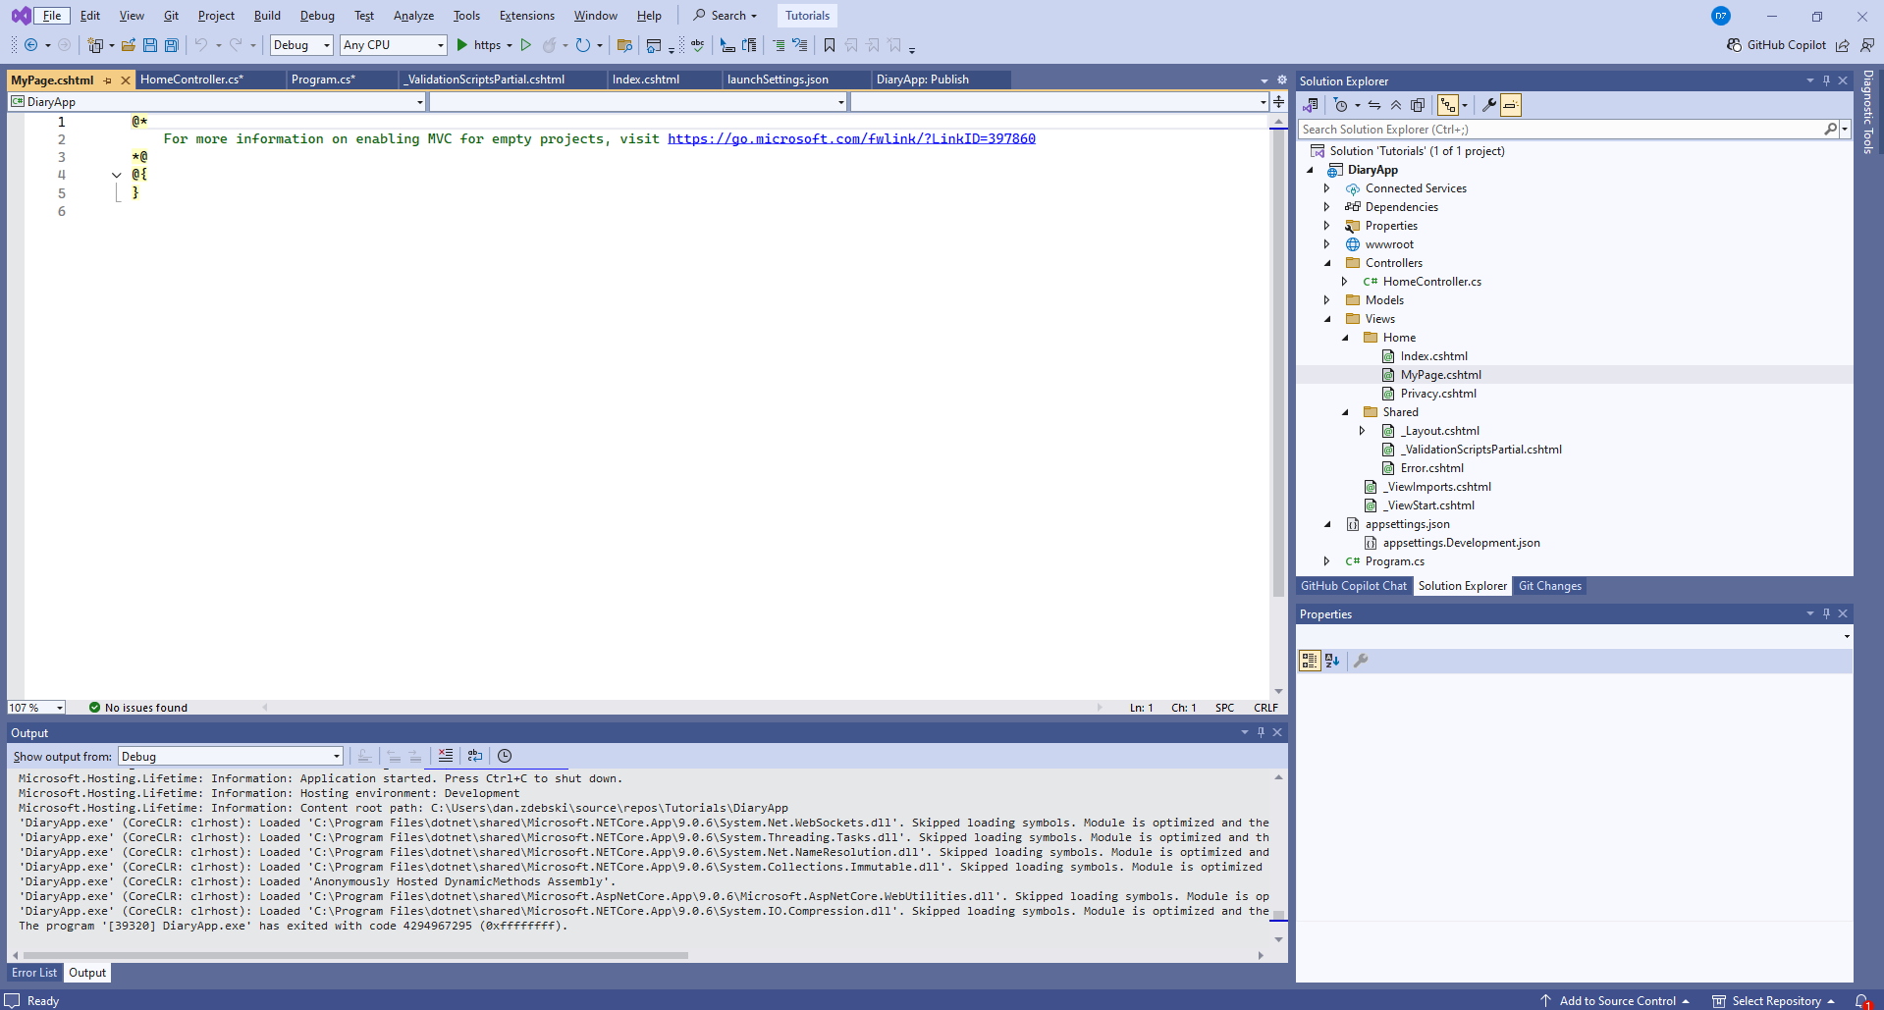
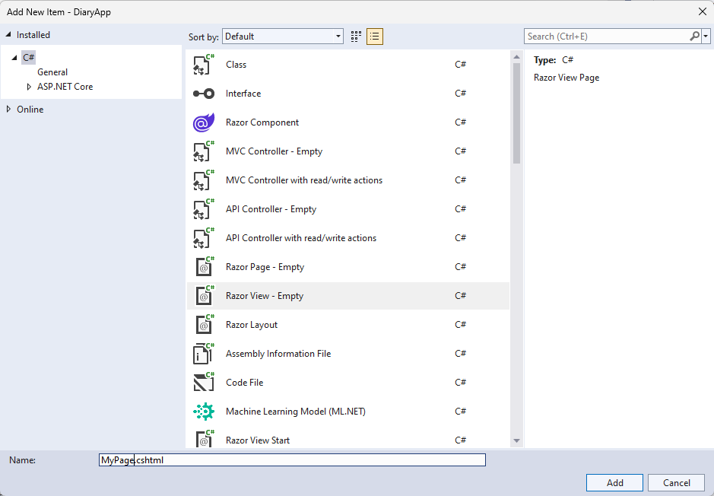
Create user build route
- In the HomeController.cs add:
public IActionResult MyPage()
{
return View();
}

Slide 59
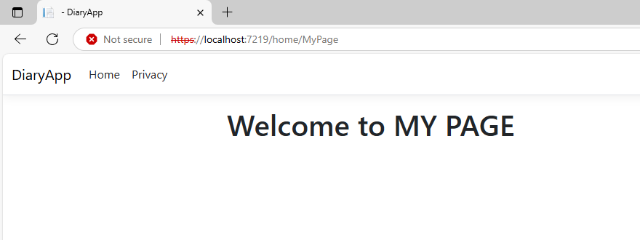
@*
For more information on enabling MVC for empty projects, visit https://go.microsoft.com/fwlink/?LinkID=397860
*@
@{
}
<h1>
Welcome to MY PAGE
</h1>

